Slide 1

TOPIC #4 Over-the-Air Update Strategies via 5G
Matthias Weiß Universität Stuttgart

Slide 2

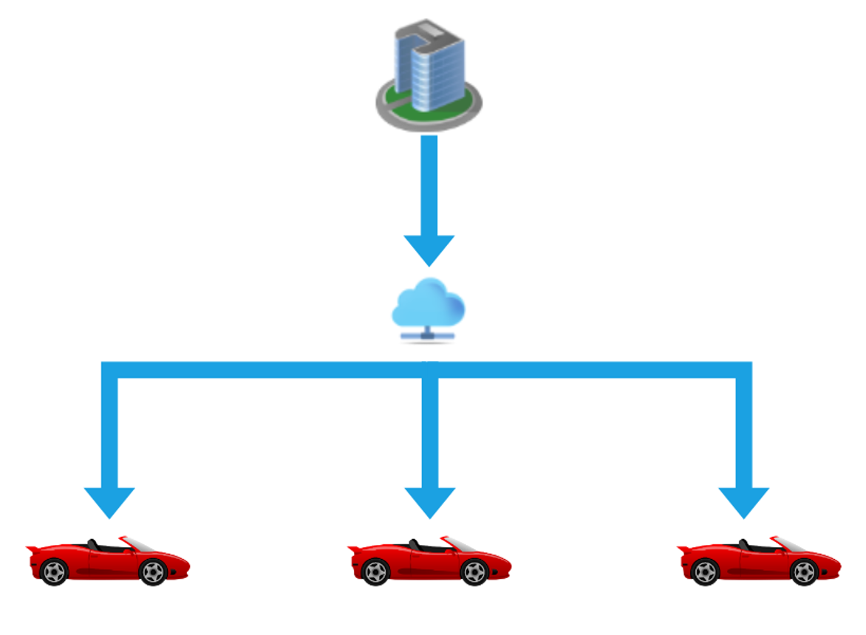



Over-the-Air Update Strategies via 5G
HACKATHON TOPIC #4
Platzhalter Bild
Challenge
Default scenario: Distributed deployment between 5G clients and servers inside Arena2036
Advanced: Introduction of edge cache, move servers to actual cloud
Level
Problem description
Implement the default scenario and conduct 5G measurements for different OTA strategies
Expand the prototype by implementing the edge cache and moving the server to cloud backend
Approach
Standalone 5G network by Nokia
Java Service Backend on Linux
Cloud/Edge technologies
Clients such as Raspberry Pis
Please keep in mind …
Good to very good programming skills in Java
Motivation to gain hands-on experience with OTA updates, 5G technologies etc.
Knowledge in Git, SSH, Shell/Bash, microcontrollers like Raspberry Pis, cloud/edge computing concepts, and web development

Slide 3





Over-the-Air Update Strategies via 5G
HACKATHON TOPIC #4
MENTOR AVAILABILITY FOR SPARRING & COACHING
FRIDAY | 10.11.2023
13:00 am – open end
SATURDAY | 11.11.2023
08:00 am – open end
Matthias Weiß
Universität Stuttgart
matthias.weiss@ias.uni-stuttgart.de

Slide 4
Over-the-Air Update Strategies via 5G
HACKATHON TOPIC #4
MENTOR AVAILABILITY FOR SPARRING & COACHING
FRIDAY | 10.11.2023
13:00 am – open end
SATURDAY | 11.11.2023
08:00 am – open end
Miles Stötzner
Universität Stuttgart
miles.stoetzner@iste.uni-stuttgart.de

